Slide 1
Understanding the role of global food trade on the transmission dynamics of antibiotic-resistant foodborne bacteria
Alex Morgan

Slide 2
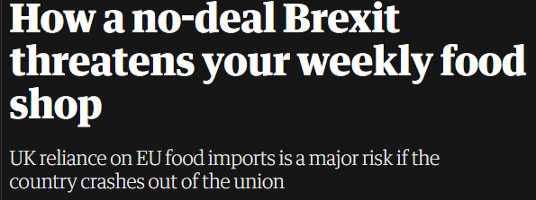
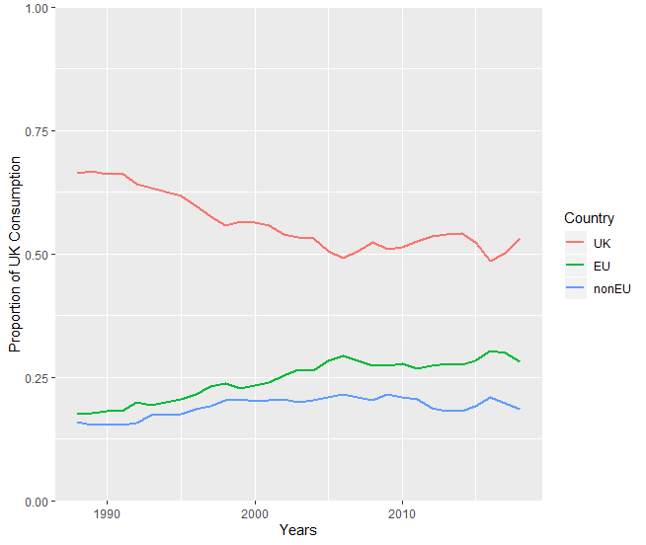
Introduction
The risk of AMR transmission through the food chain is poorly understood.
Food Standards Agency (2016) – Systematic Review of AMR bacteria in food at UK retail:
“There is a need for more studies to quantify the contribution of both domestic and imported foods to AMR occurrence…”
Drivers of AMR in domestic/imported food products could include:
Country-level heterogeneity in livestock antibiotic usage.
Food product import trade networks into the “sink” country
Notes:
https://www.food.gov.uk/research/foodborne-diseases/a-systematic-review-of-amr-bacteria-in-pork-poultry-dairy-products-seafood-and-fresh-produce-at-uk-retail-level
The figures show that over the last few decades UK consumption of domestic origin food products has been decreasing, with steady increases in the use of EU food products and a small increases in the use of non-EU food products.
For the usage parameter - it would be accurate to use the current plateau in the domestic food usage we have seen over the past few years (2005-2018).
DEFRA data for UK food origin of domestic consumption

Slide 3
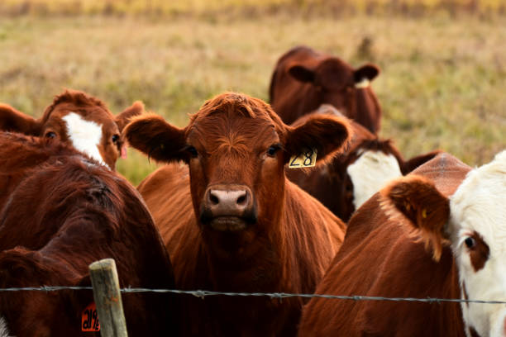



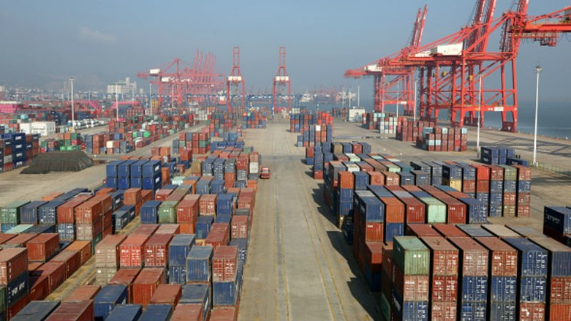
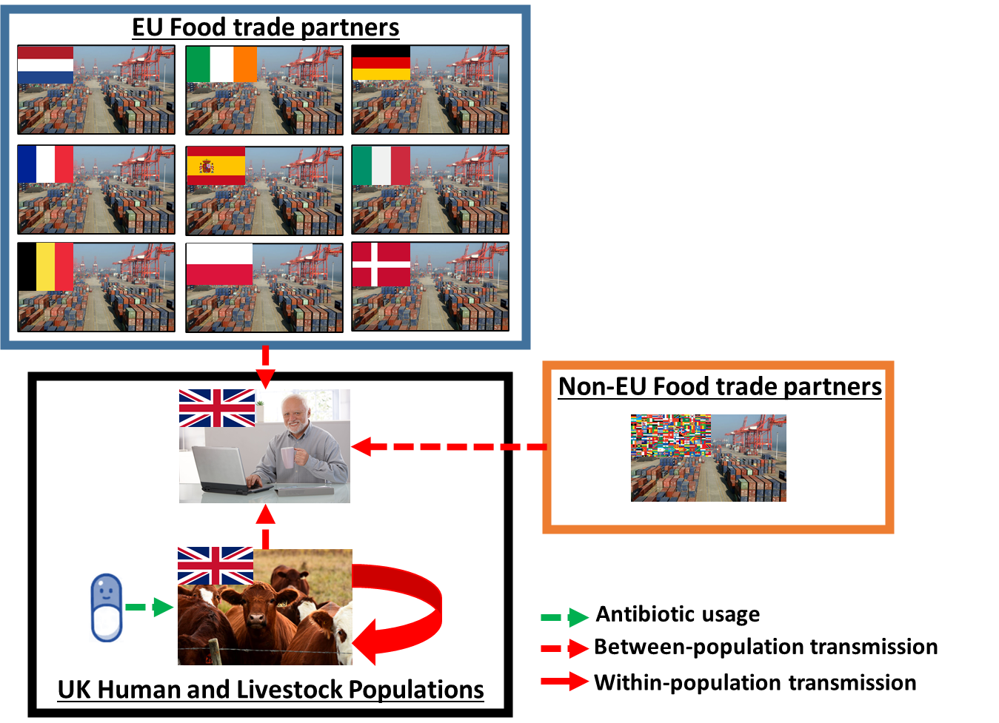
Introduction - Hypothesis
Aim of one health interventions are to change intervene in one population - leading to beneficial results in connected populations
Reduce livestock resistance -> reduce human resistance
Transmission pressure from livestock is NOT homogenous
However, transmission pressure from livestock is heterogeneous and not all livestock populations will be affected by “local” (domestic) livestock interventions
There is the potential for local livestock interevntions to get “saturated” by interventions from other sources (imported food?)
Domestic
Livestock
Resistance
Humans
Imported
Food
Notes:
https://www.food.gov.uk/research/foodborne-diseases/a-systematic-review-of-amr-bacteria-in-pork-poultry-dairy-products-seafood-and-fresh-produce-at-uk-retail-level
The figures show that over the last few decades UK consumption of domestic origin food products has been decreasing, with steady increases in the use of EU food products and a small increases in the use of non-EU food products.
For the usage parameter - it would be accurate to use the current plateau in the domestic food usage we have seen over the past few years (2005-2018).
DEFRA data for UK food origin of domestic consumption

Slide 4
Aims
Chapter Aim:
Understand how importation of food products can affect local AMR dynamics and livestock interventions
Part 1 – Understanding the impact of importation
Basic analysis to identify the general importance of importation on the efficacy of livestock antibiotic stewardship to reduce livestock/human resistance
Part 2 – Assessing the dynamics of a food trade importation network on the efficacy of domestic livestock antibiotic stewardship
Adapt the model for a realistic trade network – using the UK as a case study
Assess how the characteristics of a realistic trade network can affect the dynamics of AMR transmission and the efficacy of livestock antibiotic curtailment

Slide 5
Methods – Part 1
Non-UK Food Import
“Simple” model
Treats the imported food as a homogenous source of transmission
Allows us to explore the general influence of import in a livestock/human transmission model
Specifically the effect of curtailment interventions
Livestock interventions only affect DOMESTIC livestock
UK Human and Livestock Populations
Antibiotic Usage
Population-level transmission
Within-population transmission

Slide 6
Methods – Part 2
“Complex” model
Stratifies out the imported transmission pressure into individual countries with specific contamination and resistance
Separate out EU and nEU import pressure (why)
Allows us to assess the influence of greater heterogeneity of import on the efficacy of curtailment interventions

Slide 7
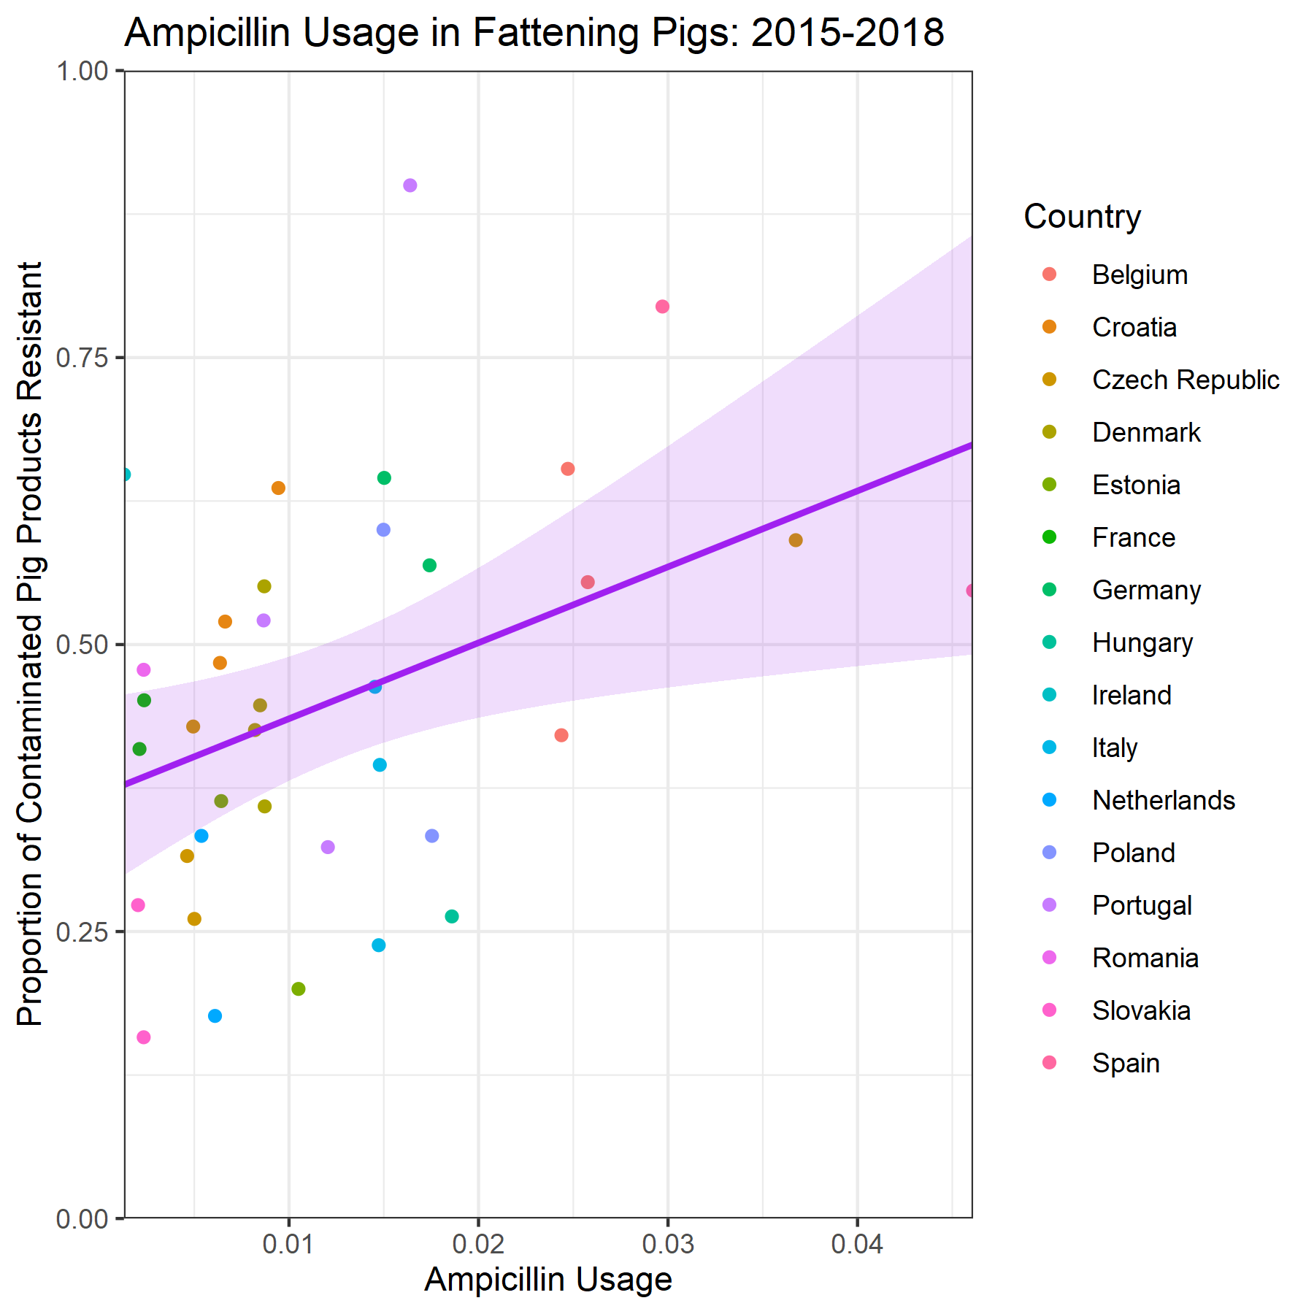
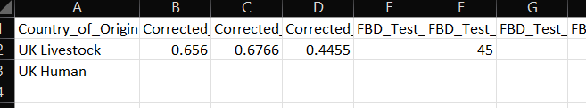
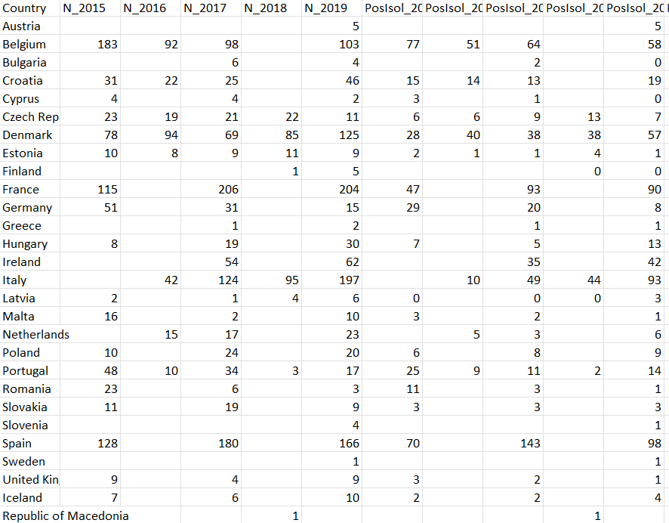
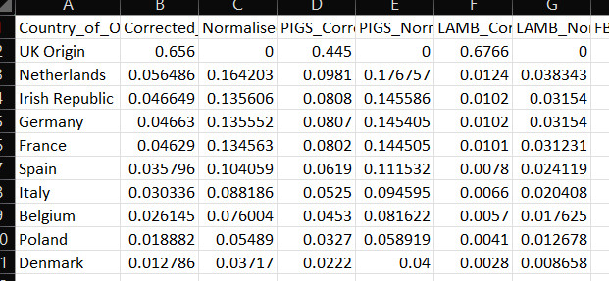
Methods – Datasets
3 Datasets are required
UK Specific Parameterisation
General Resistance/Usage Dataset
Import Parameterisation
Outcome Measures to Fit
Relationship between antibiotic usage and resistance (general)
Part 2 Model – contamination and resistance in imported food products (Import)
Specific and general
UK Human foodborne disease and resistance (UK)
UK Livestock foodborne contamination and resistance (UK)
(Coefficient = 6.61, p = 0.0145)
Use approximate Bayesian computation (sequential monte carlo) – ABC-SMC - model fitting to ensure that model is fitted to ampicillin-resistance in fattening pigs case study

Slide 8
Methods – Datasets: Specifics
UK Specific Parameterisation
Parameterise contamination/infection and resistance in UK livestock and human populations.
Taken from epidemiological studies and ECDC data
Eta parameter used to “transform” prevalence in caecum to contamination on UK swine carcasses.
General Resistance/Usage Dataset
Parameterise the relationship between antibiotic usage and resistance.
ECDC and EFSA data on livestock ampicillin sales and ampicillin resistance in pigs from different EU countries
Stratified by years (temporal data represents single data points)
EFSA antibiotic sales data standardised to pig sales/usage using pig population correction unit calculations
Import Parameterisation
Parameterise the contamination and resistance for importing countries
Determine the % share of each importing country to the UKs total food supply.
Requires tweaking according to livestock food product modelled
Resistance data taken from 400cm2 swabs on carcasses only

Slide 9
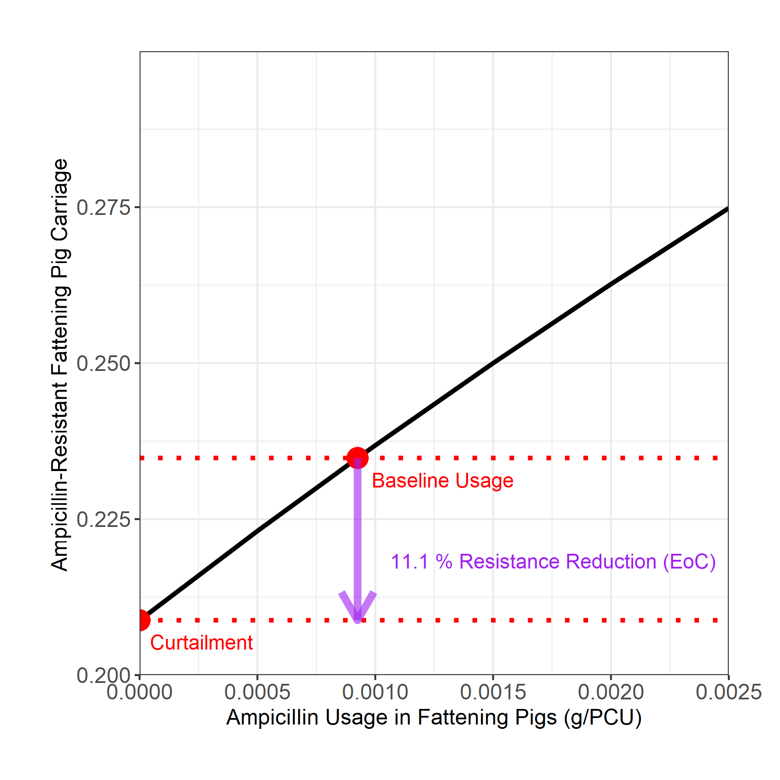
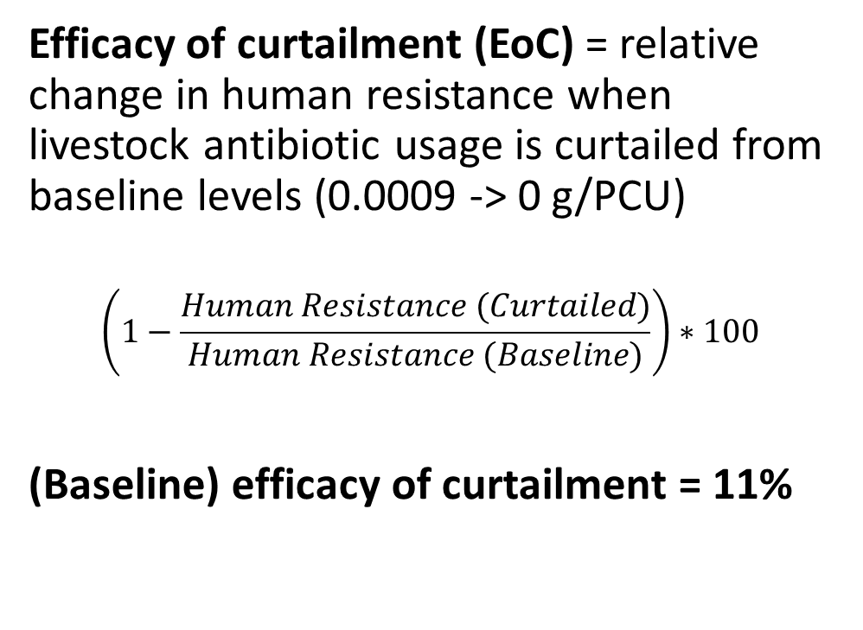
Methods – Outcome Measure
Efficacy of curtailment (EoC) = relative change in human resistance when livestock antibiotic usage is curtailed from baseline levels (0.0009 -> 0 g/PCU)
$$\left(1−\frac{Human Resistance (Curtailed)}{Human Resistance (Baseline)}\right)∗100$$
(Baseline) efficacy of curtailment = 11%

Slide 10
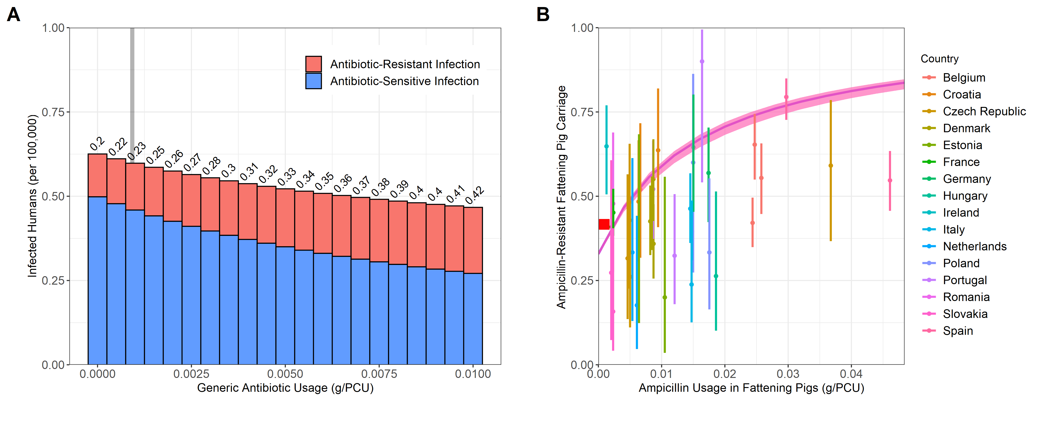
Results – Part 1 Basic Output
Model has been successfully fitted to all outcome measures – including EFSA/ECDC data for the relationship between usage and resistance.
We model similar dynamics to the model in Chapter 2 upon livestock antibiotic curtailment:
Slight increase in foodborne disease
Reduction in resistance.
Distance – Distance % (Target)
Incidence -
I_{CombA} -
Human Resistance -
Livestock Resistance -

Slide 11
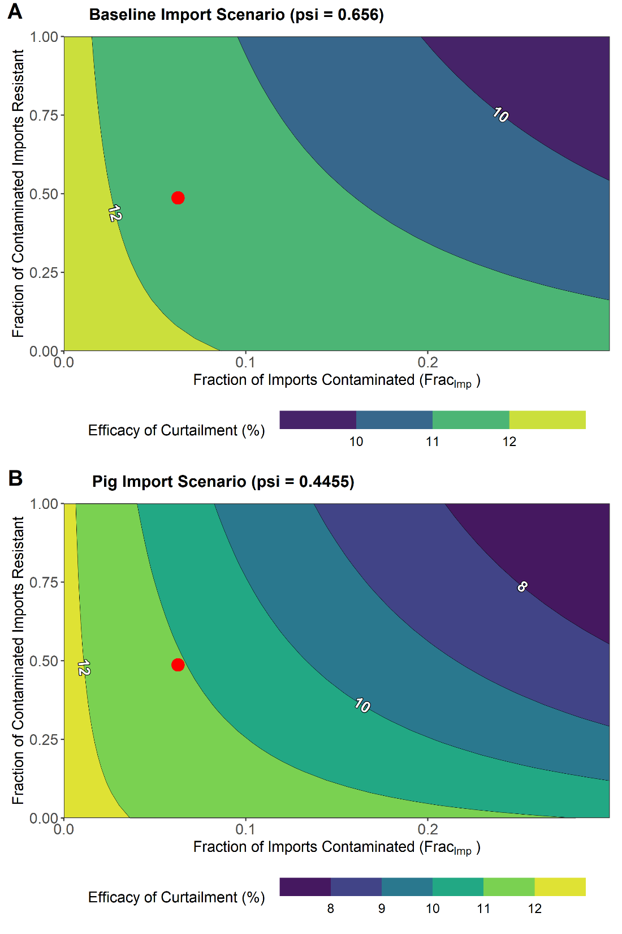
Results – Part 1 Import
We assess the fitted model (ψ = 0.656) and explore:
Fraction of imported food products contaminated
Fraction of contaminated imports resistant
Compare against alternative case study (ψ = 0.4455) - pig imports.
DARKER – lower efficacy of local antibiotic curtailment
LIGHTER – higher efficacy of local antibiotic curtailment
Increasing imports reduces the ability for curtailment to reduce resistance

Slide 12
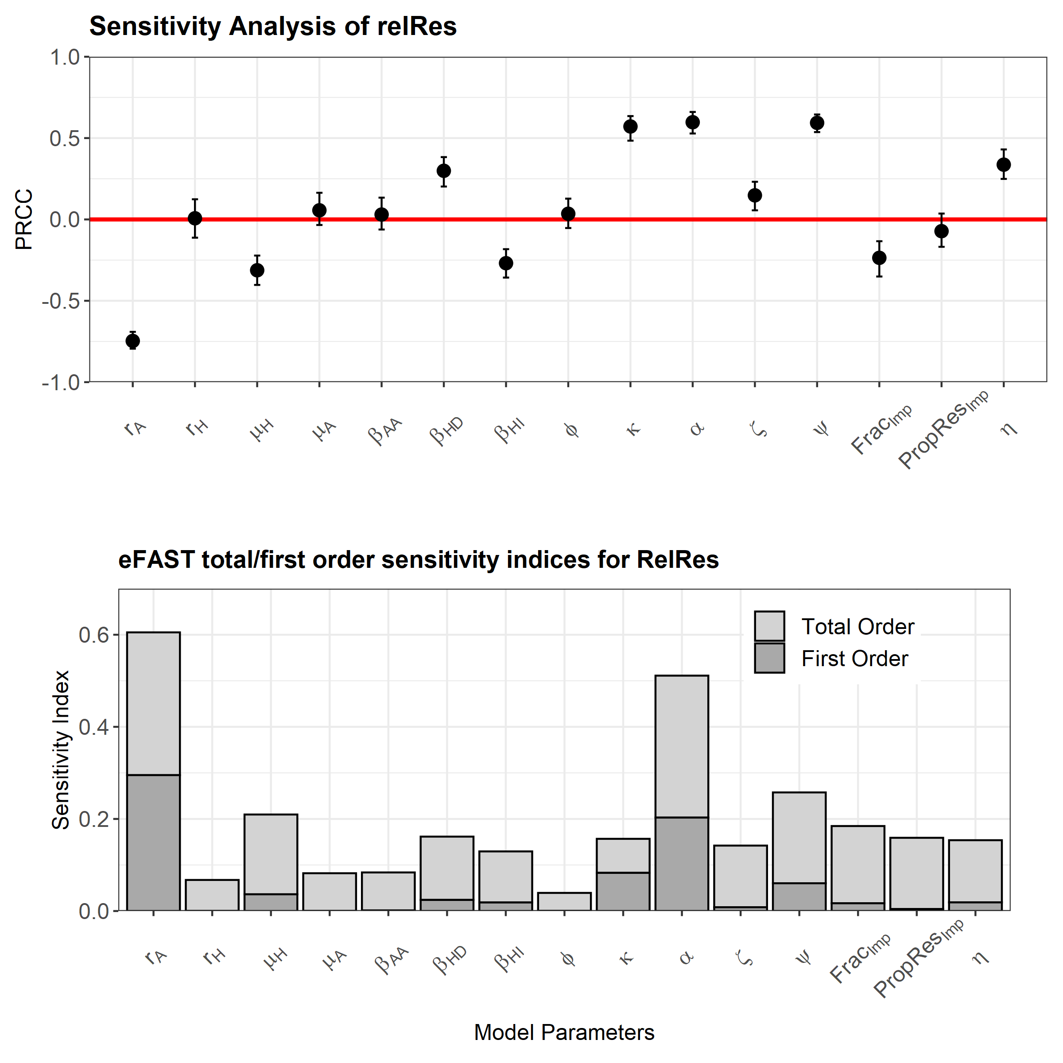
Results – Part 1 Sensitivity Analysis
Latin-hypercube sampling Partial Rank Correlation Coefficient (LHS-PRCC)
Parameter | Parameter Description | Increases do what to Efficacy?
β_{HD}
β_{HI}
ψ
Frac_{Imp}
PropRes_{Imp}
η
Extended Fourier Amplitude Sensitivity Test (EFAST)
Notes:
Parameters which promote import – will reduce the efficacy of the intervention – betaHD and betaHI and psi
Parameters which promote more contamination on food products will reduce the efficacy of the intervention
We can also see that the majority of these import parameters have a relative high importance on the outcome measure (eFAST) – but a lot of the importance is comprised of interaction effects with other parameters – if the first order effects only comprise a small proportion of the total order effects – then second order or higher order effects are driving most of the variation in the outcome measure.
For example a parameter might interact with another parameter which together will drive a lot of the variation seen in the model outcome measure.
This also makes sense – that they have an interaction effect – because of the multiplicative way I have modelled the import.

Slide 13
Interim Conclusion – Part 1
Model can be fitted to ECDC/EFSA data and UK human outcome measures can also be fitted.
Basic dynamics are observed – with increases in foodborne disease and decreases in resistance.
Import results in the reduction in the efficacy of one health interventions (on human resistance).
Parameters which favour import and increase the level of contamination will decrease the efficacy of local intervention strategies.

Slide 14
Results – Part 2 Model Fit and Basic Output

Slide 15
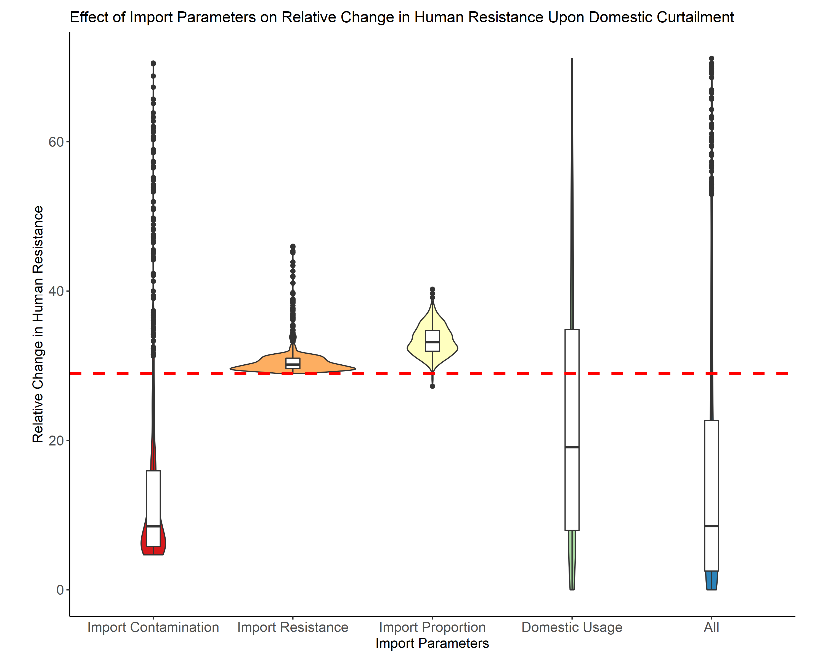
Results – Part 2 Uncertainty Analysis
Uncertainty/Scenario Analysis

Slide 16
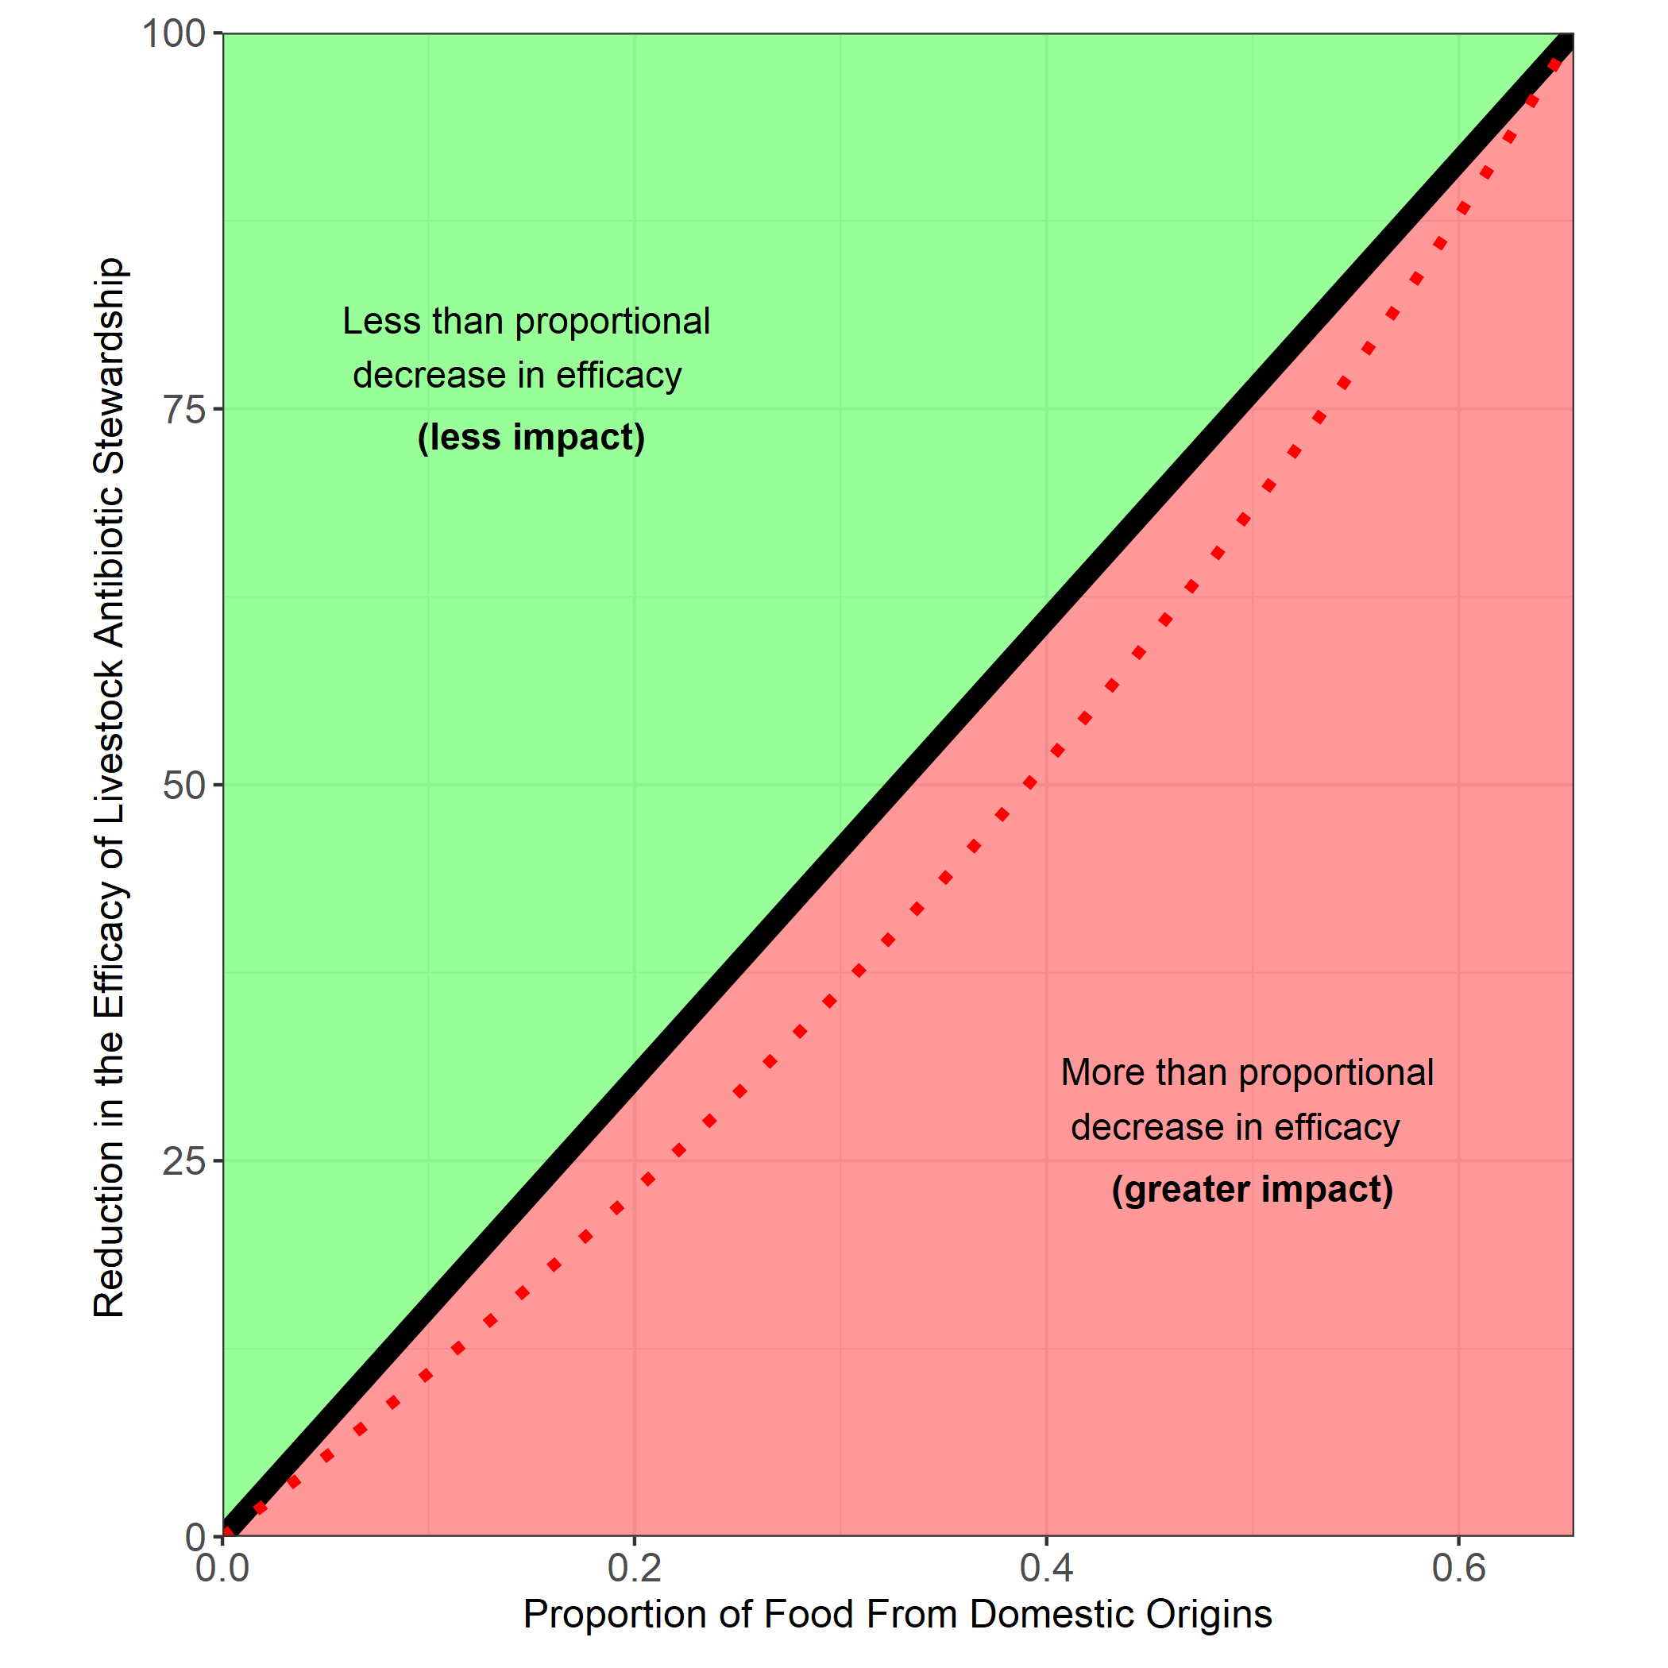
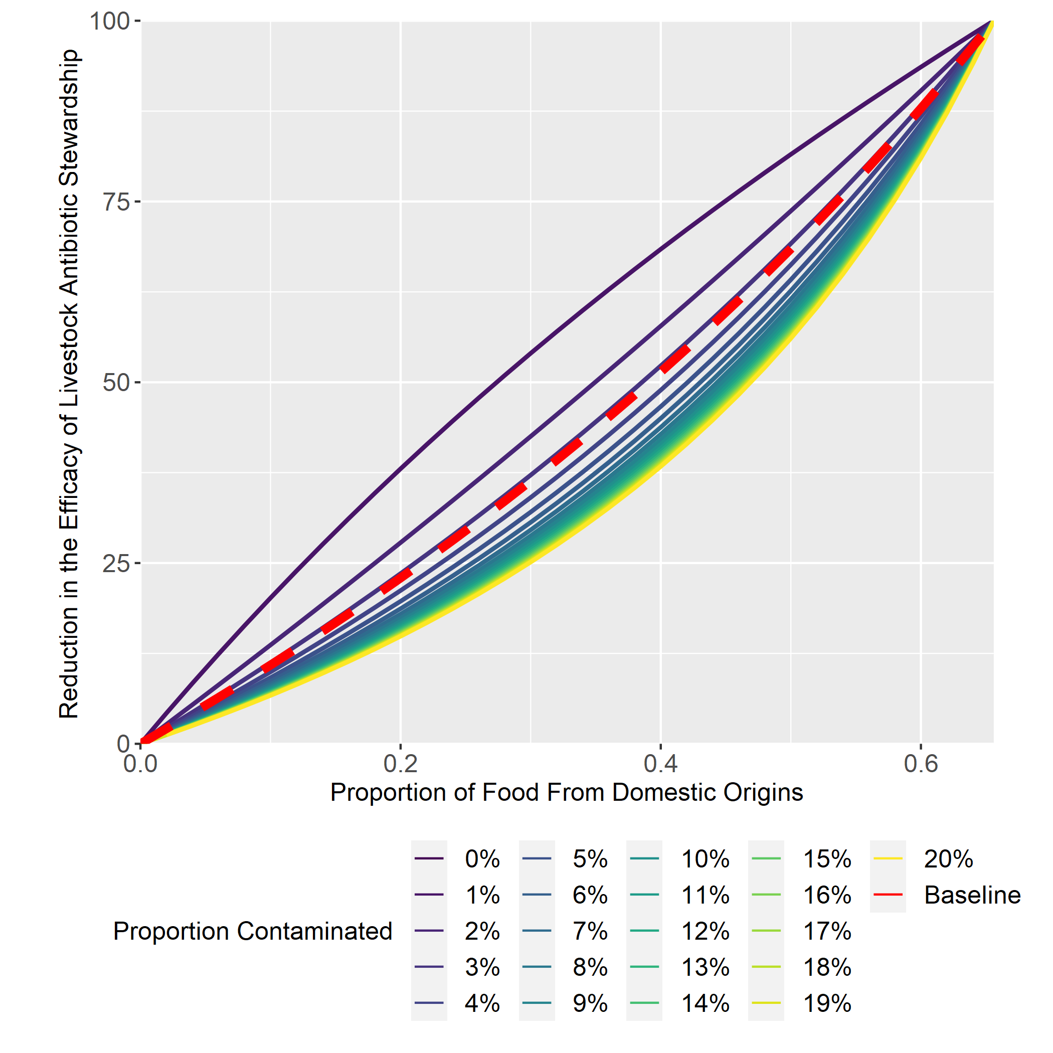
Results – Part 2 Effect of Import

Slide 17
Results – Part 2 Effect of Import
Uncertainty Analysis

Slide 18
Interim Conclusion – Part 2
The proportion of food products from a domestic origin (ψ), is an important parameter in determining the efficacy of livestock antibiotic curtailment.
Under baseline UK parameters, decreasing the proportion of food products from domestic sources will result in a greater than proportional decrease in the efficacy of livestock antibiotic curtailment.
To safely increase the proportion of food products from imported sources, the average level of contamination on imported food products must be reduced to low levels (0-2%), resulting in a less than proportional decrease in efficacy of livestock antibiotic curtailment.

Slide 19
Overall Conclusions
Interventions to reduce livestock resistance need to be systematic – otherwise reductions to livestock resistance can be offset by influence from other locations.

Slide 20





Acknowledgements
Many Thanks to:
University of Edinburgh
Prof Mark Woolhouse
Dr Bram van Bunnik
Prof Dan Nussey
Epigroup
Technical University of Denmark (DTU)
Håkan Vigre
Frank Aarestrup

Slide 21
r_{A}
I_{SH}
μ_{H}
τ
ηψβ_{HD}
(1-ψ)β_{HI}
I_{SA}
IMP_{SA}
μ_{A}
½ ζ
r_{H}
Impsa = 1-resistance*contamiantion
Impra = resistance* contamination
β_{AA}
S_{A}
S_{H}
μ_{A}
φ
τθ
μ_{H}
μ_{H}
μ_{A}
αβ_{AA}
½αζ
I_{RA}
r_{H}
IMP_{RA}
μ_{A}
ηψαβ_{HD}
(1-ψ)αβ_{HI}
I_{RH}
r_{A}
μ_{H}
LIVESTOCK
IMPORTED FOOD
HUMANS

Slide 22
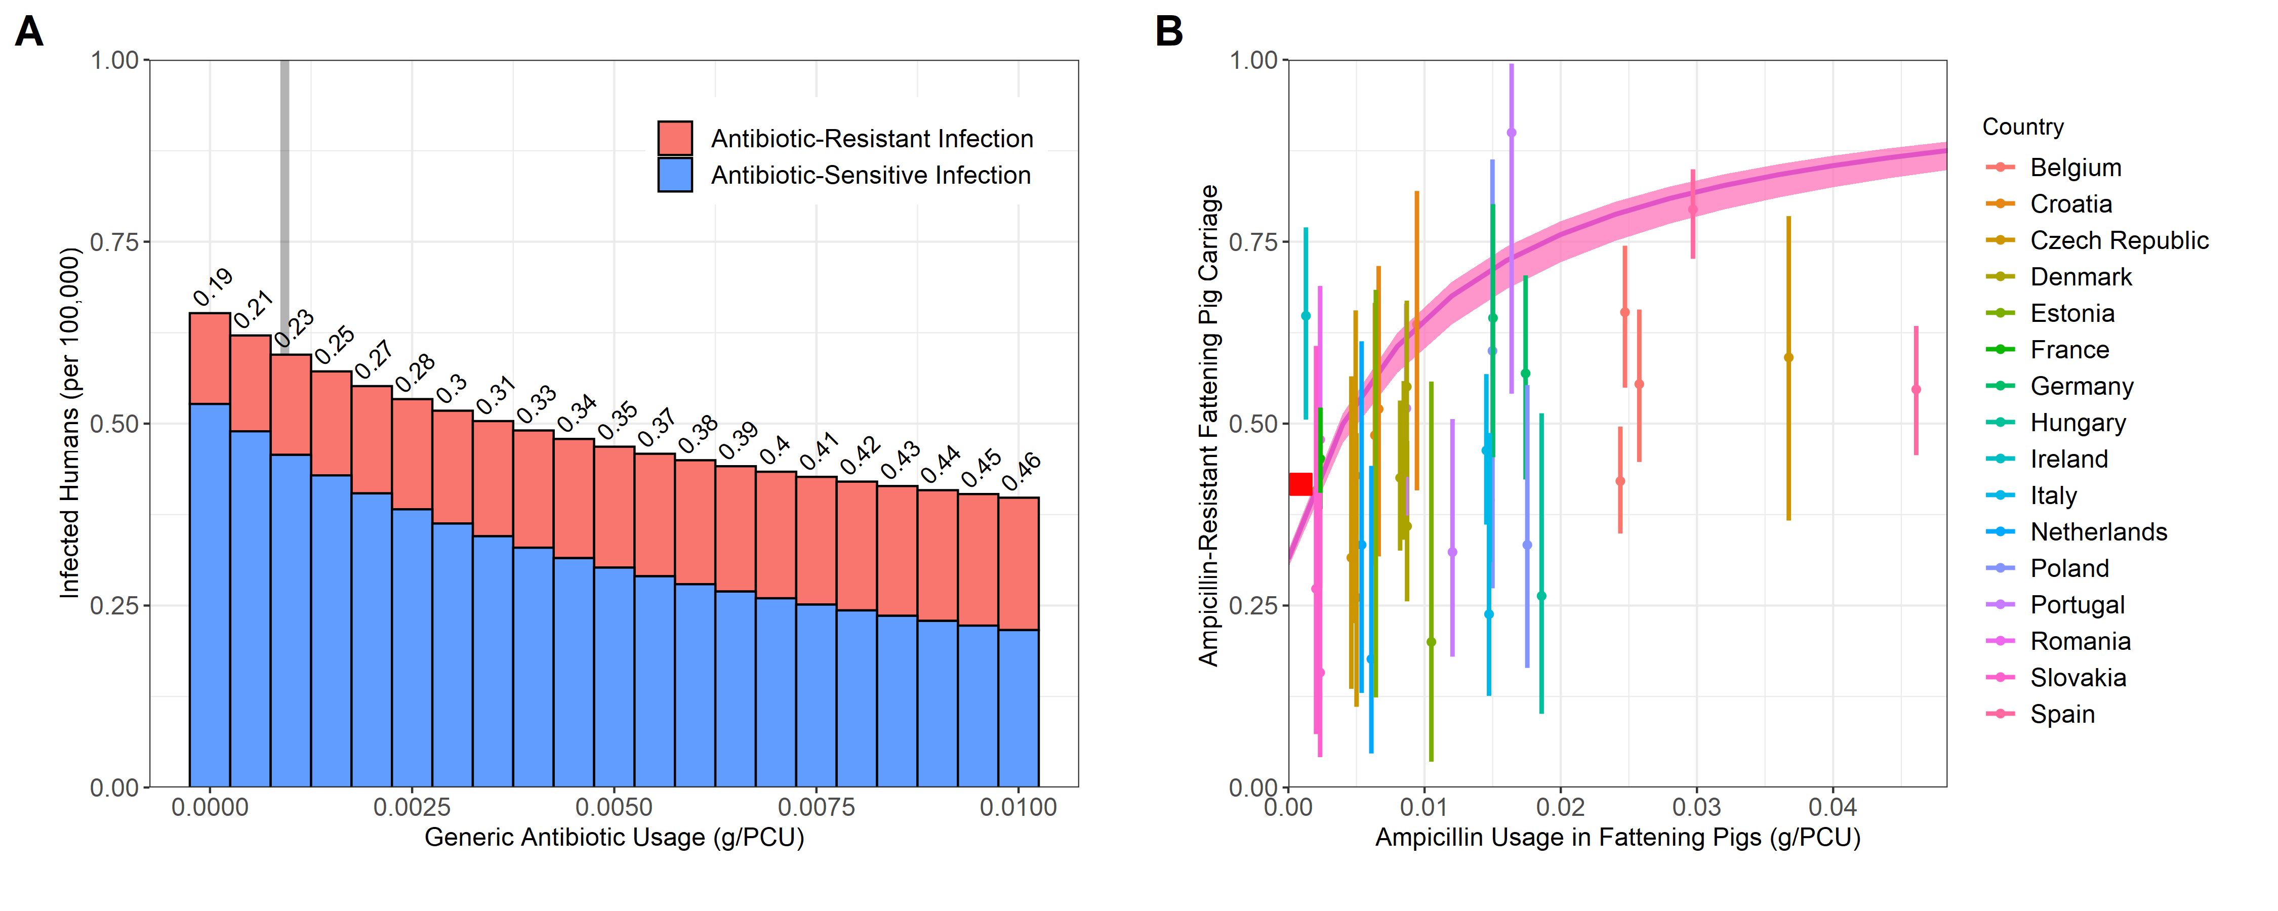
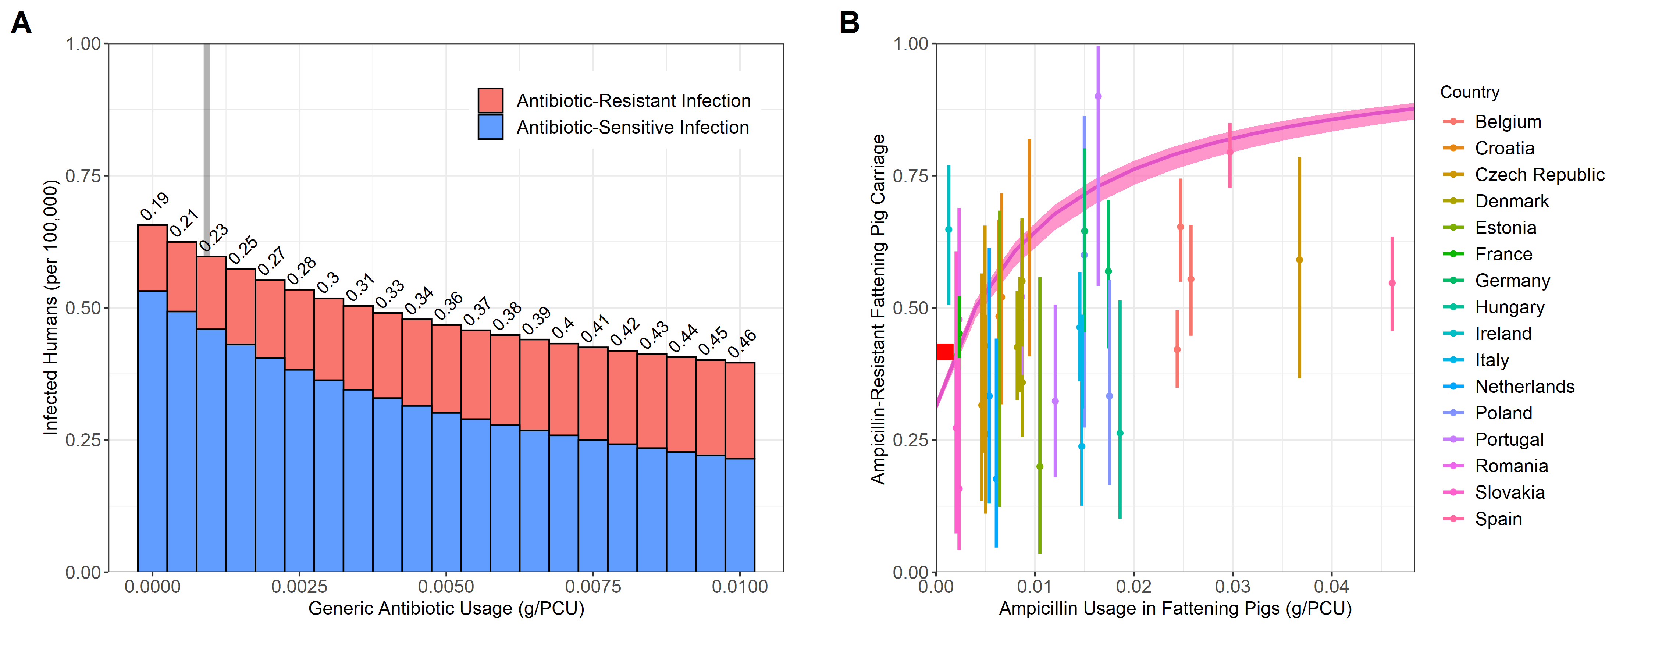

Slide 23
